Slide 1
Lecture 6
Chapter-02
Discrete-Event System Simulation
-Jerry Banks
Simulation of Queuing System
Simulation of Inventory Systems

Slide 2
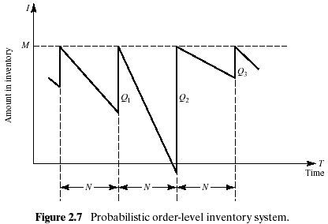
Simulation of Inventory Systems (1)
This inventory system has a periodic review of length N, at which time the inventory level is checked.
An order is made to bring the inventory up to the level M.
In this inventory system the lead time (i.e., the length of time between the placement and receipt of an order) is zero.
Demand is shown as being uniform over the time period

Slide 3
Simulation of Inventory Systems (2)
Notice that in the second cycle, the amount in inventory drops below zero, indicating a shortage.
Two way to avoid shortages
  Carrying stock in inventory
  : cost - the interest paid on the funds borrowed to buy the items, renting of storage space, hiring guards, and so on.
  Making more frequent reviews, and consequently, more frequent purchases or replenishments
  : the ordering cost
The total cost of an inventory system is the measure of performance.
  The decision maker can control the maximum inventory level, M, and the length of the cycle, N.
  In an (M,N) inventory system, the events that may occur are: the demand for items in the inventory, the review of the inventory position, and the receipt of an order at the end of each review period.

Slide 4

Simulation of Inventory Systems (3)
Example 2.3 The Newspaper Seller’s Problem
  A classical inventory problem concerns the purchase and sale of newspapers.
  The paper seller buys the papers for 33 cents each and sells them for 50 cents each. (The lost profit from excess demand is 17 cents for each paper demanded that could not be provided.)
  Newspapers not sold at the end of the day are sold as scrap for 5 cents each. (the salvage value of scrap papers)
  Newspapers can be purchased in bundles of 10. Thus, the paper seller can buy 50, 60, and so on.
  There are three types of newsdays, “good,” “fair,” and “poor,” with probabilities of 0.35, 0.45, and 0.20, respectively.

Slide 5
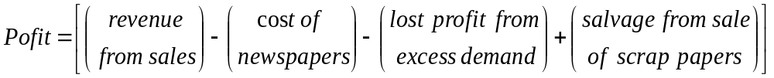
Simulation of Inventory Systems (4)
Example 2.3 (Cont.)
  The problem is to determine the optimal number of papers the newspaper seller should purchase.
  This will be accomplished by simulating demands for 20 days and recording profits from sales each day.
  The profits are given by the following relationship:
  The distribution of papers demanded on each of these days is given in Table 2.15.
  Tables 2.16 and 2.17 provide the random-digit assignments for the types of newsdays and the demands for those newsdays.

Slide 6
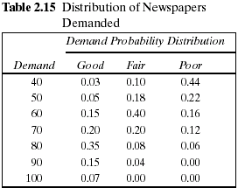
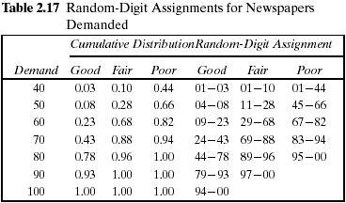
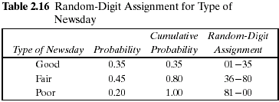
Simulation of Inventory Systems (5)

Slide 7
Simulation of Inventory Systems (6)
Example 2.3 (Cont.)
  The simulation table for the decision to purchase 70 newspapers is shown in Table 2.18.
  The profit for the first day is determined as follows:
  Profit = $30.00 - $23.10 - 0 + $.50 = $7.40
    On day 1 the demand is for 60 newspapers. The revenue from the sale of 60 newspapers is $30.00.
    Ten newspapers are left over at the end of the day.
    The salvage value at 5 cents each is 50 cents.
  The profit for the 20-day period is the sum of the daily profits, $174.90. It can also be computed from the totals for the 20 days of the simulation as follows:
  Total profit = $645.00 - $462.00 - $13.60 + $5.50 = $174.90
  The policy (number of newspapers purchased) is changed to other values and the simulation repeated until the best value is found.

Slide 8
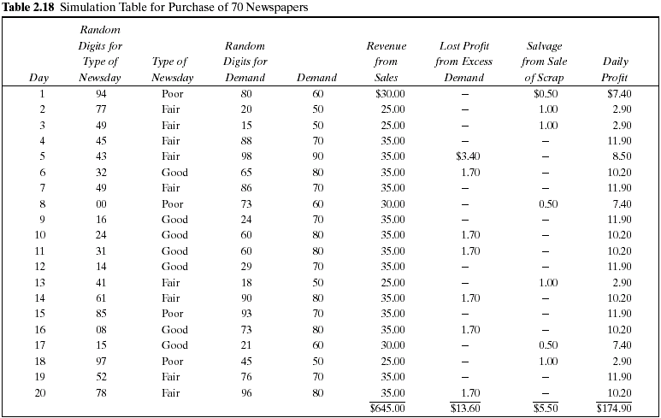

Slide 9
Simulation of Inventory Systems (7)
Example 2.4 Simulation of an (M,N) Inventory System
  This example follows the pattern of the probabilistic order-level inventory system shown in Figure 2.7.
  Suppose that the maximum inventory level, M, is11 units and the review period, N, is 5 days. The problem is to estimate, by simulation, the average ending units in inventory and the number of days when a shortage condition occurs.
  The distribution of the number of units demanded per day is shown in Table 2.19.
  In this example, lead time is a random variable, as shown in Table 2.20.
  Assume that orders are placed at the close of business and are received for inventory at the beginning of business as determined by the lead time.

Slide 10
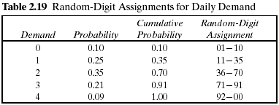
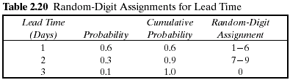
Simulation of Inventory Systems (8)
Example 2.4 (Cont.)
  For purposes of this example, only five cycles will be shown.
  The random-digit assignments for daily demand and lead time are shown in the rightmost columns of Tables 2.19 and 2.20.

Slide 11
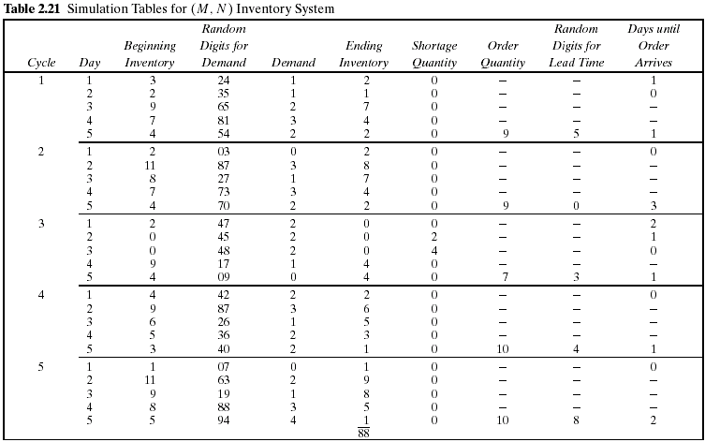

Slide 12
Simulation of Inventory Systems (9)
Example 2.4 (Cont.)
  The simulation has been started with the inventory level at 3 units and an order of 8 units scheduled to arrive in 2 days' time.
Beginning Inventory of Third day
Ending Inventory of 2 day in first cycle
=
+
new order
  The lead time for this order was 1 day.
  Notice that the beginning inventory on the second day of the third cycle was zero. An order for 2 units on that day led to a shortage condition. The units were backordered on that day and the next day also. On the morning of day 4 of cycle 3 there was a beginning inventory of 9 units. The 4 units that were backordered and the 1 unit demanded that day reduced the ending inventory to 4 units.
  Based on five cycles of simulation, the average ending inventory is approximately 3.5 (88 ÷ 25) units. On 2 of 25 days a shortage condition existed.

